Slide 1
EE-542 Lab-5 Fast Reliable File Transfer over TCP/IP
Team:
Haoyu Guo
Rocha Zhou

Slide 2
Given Task
Explore the problem space by varying the delay and loss up to 200ms delay and 25% loss (both directions, so 400ms RTT and 50% total packet loss). What throughput can FTP achieve under these conditions? You may want to present this as a 3D graph, or one graph with multiple lines.
Modifying TCP Module
Start by reading the paper “Removing Exponential Backoff from TCP” [1]. Start with the standard TCP stack for Linux and remove the exponential backoff algorithm as described in the paper. Make sure to understand the implicit packet conservation principal. For the full credit, you will need to achieve at least 10 Mbps performance of FTP over TCP/IP from n0 to n1 over 100 Mbps/200ms delay/20% packet loss.
Evaluation
Evaluate your improvements to TCP perform the same experiment as above with SCP, except include your modified TCP stack and/or router. If you do more than one modification, make sure to test and evaluate each modification separately (and together) to see which change improves performance under what conditions.

Slide 3
Explaination
The main files that handle the TCP code in the kernel are list here. Many of these files could be found under net/ipv4/ folder in the linux kernel code.
tcp.h: this files includes the TCP related definitions, including the data structures defined above.
tcp.c: includes general TCP code and covers the interface between different sockets and the rest of the TCP code.
tcp_input.c: this is the biggest and most important file dealing with incoming packets from the network. It also contains the code for recovery state machine.
tcp_output.c: this files deals with sending packets to the network. It contains some of the functions that are called from the CC framework.
tcp_ipv4.c: IPv4 TCP specific code. This function hands the relevant packets to the CC framework.
tcp_timer.c: implements timer management functions.
tcp_cong.c: implements pluggable TCP congestion control support and CC’s core framework with default implementation of New Reno logic.
tcp_[name of algorithm].c: these files implement different algorithm specific congestion control logic. For example, tcp_vegas.c implements the Vegas logic and tcp_cubic.c implements the TCP Cubic.

Slide 4
tcp.h
1. Made changes in tcp.h to change the window size and doubled its size from 32767U to 65535U
2. Decreased the amount of duplicate ACKs for fast retransmit starts to 1
3. Reduced the TCP_SYN_RETRIES to wait for a shorter duration
4. TCP_RTO_MAX and TCP_RTO_MIN is modified so that we wait for a shorter duration before a broken network link is notified to the upper layer
5. TCPOPT_WINDOW is doubled so that we can accommodate more data in the payload
6. TCP_NAGLE_OFF is disabled else it would prevent us from sending large quantity of data/packets. As Nagle's algorithm concentrates on improving efficiency by cutting down the number of packets.
7. TCP_INIT_CWND is increased from 10 to 1000 so that we don’t consider the initial packet losses as congestion.
tcp.c
1. secs_to_retrans here we remove the left shift to remove the exponential back off and modify the snd_cwnd appropriately
tcp_cong.c/tcp_hybla
1. tp->snd_cwnd is modified to take the maximum tp->snd_cwnd_clamp
2. tcp_reno_ssthresh is modified to set to congestion window unit
tcp_input.c
1. tcp_incr_quickack is modified to set it to the max possible value.
2. tcp_sndbuf_expand is modified to set it to the max possible value.
3. __tcp_grow_window is modified to set the window to tp->rcv_ssthresh instead of dividing the window size by right shift.

Slide 5
Results
Before TCP Kernel Module Modification;
Delay(ms) | Loss | Throughput(Mbps) | File Size(Mbyte)
10 | 0% | 69.7 | 100
100 | 0% | 62.9 | 100
200 | 0% | 53.7 | 100
10 | 10% | 67.6 | 100
100 | 10% | 41 | 100
200 | 10% | 33.2 | 100
10 | 20% | 3.5 | 100
100 | 20% | System Stalled | 100
200 | 20% | System Stalled | 100

Slide 6
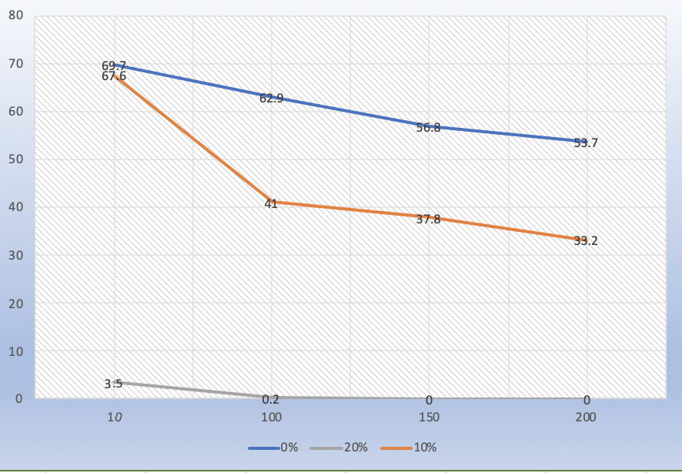
Graph of Throughput(Mbps) vs Delay(ms) for Unmodified TCP Module

Slide 8
After TCP Kernel Module Modification;
Delay(ms) | Loss | Throughput(Mbps) | File Size(Mbyte)
10 | 0% | 73 | 100
200 | 20% | 9.3 | 100
400 | 50% | System Stalled | 100
Conclusion
We can observe that by modifying the TCP kernel Module the Transfer Rate is improved compared to the existing TCP plug-able implementation models.

Slide 9
Reference
Amit Mondal and Aleksandar Kuzmanovic. Removing exponential backoff from tcp. SIGCOMM Comput. Commun. Rev. , 38:17–28, September 2008.
John Nagle. Congestion control in ip/tcp internetworks. SIGCOMM Comput. Commun. Rev. , 14:11– 17, October 1984.
Ren´e Pfeiffer. Tcp and linux’ pluggable congestion control algorithms.

